Slide 1
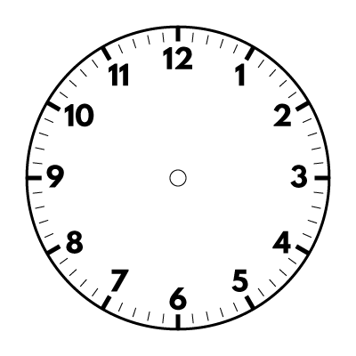
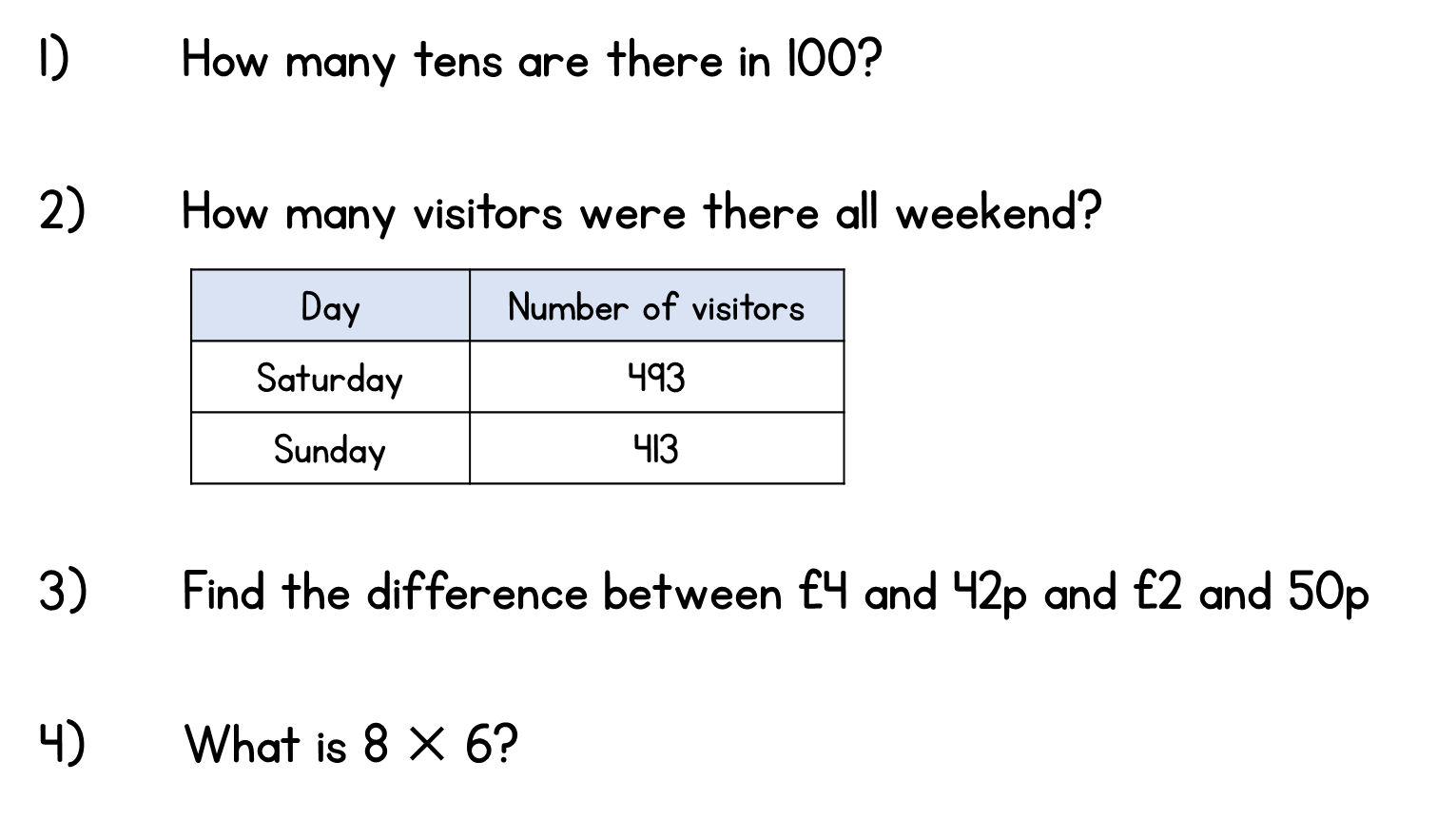




Year 3 | Week 7 | Day 1

Slide 2
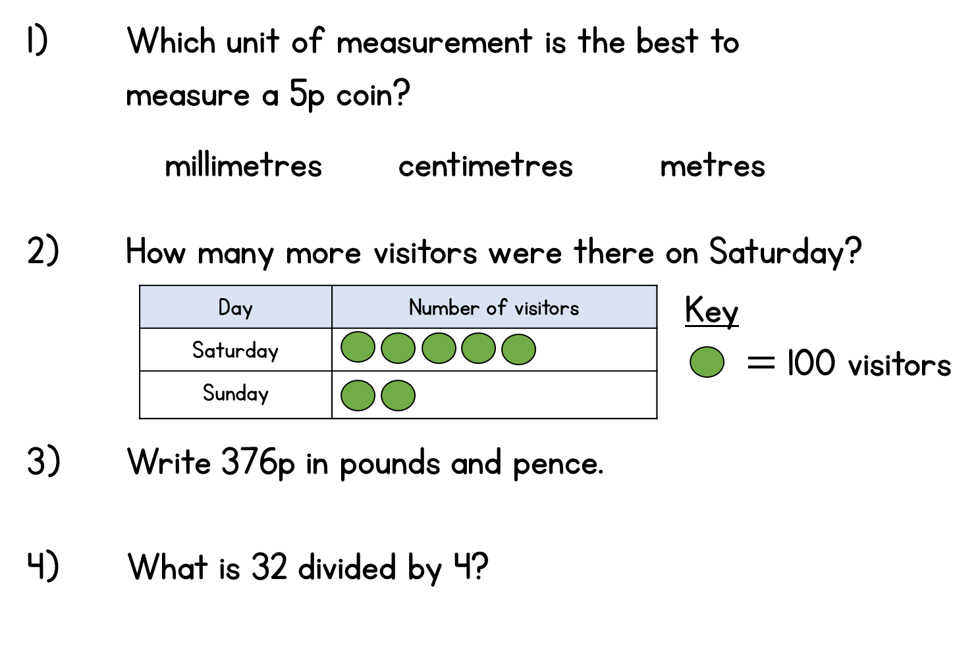



Year 3 | Week 7 | Day 2

Slide 3
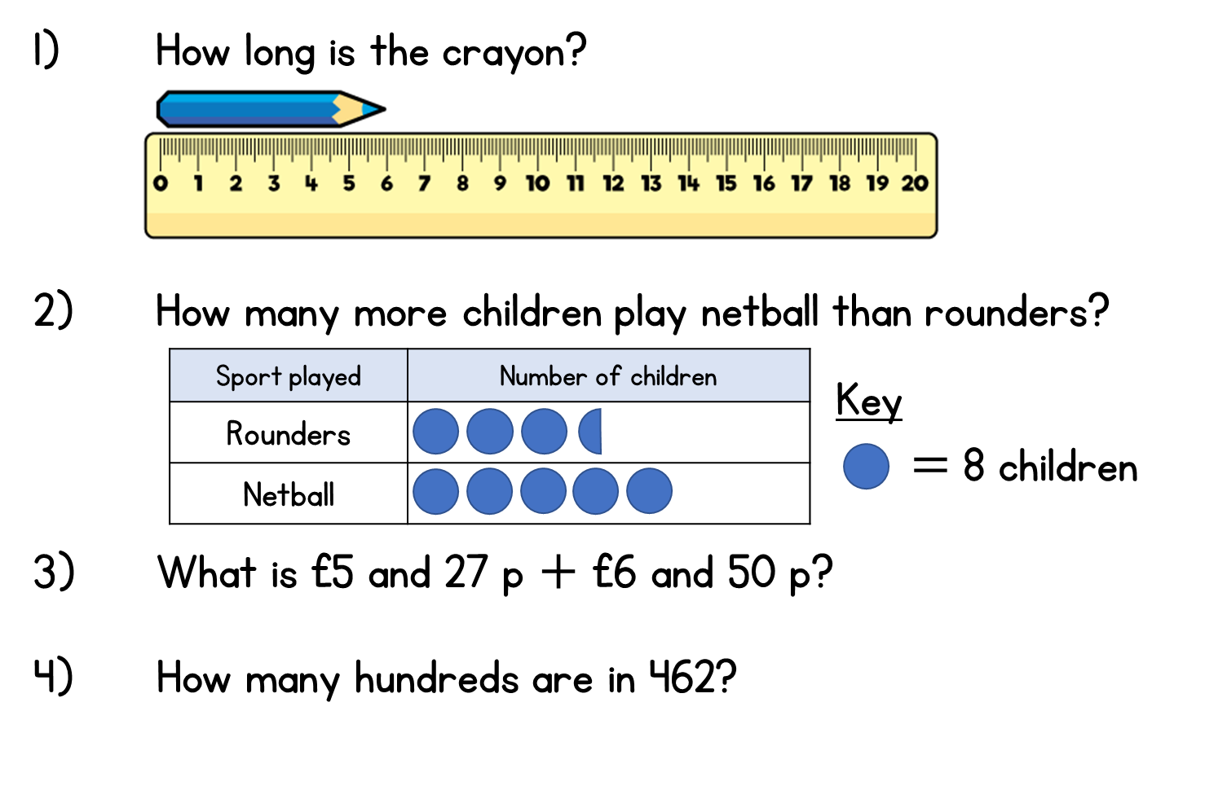
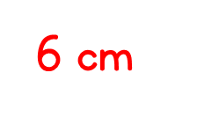



Year 3 | Week 7 | Day 3

Slide 4
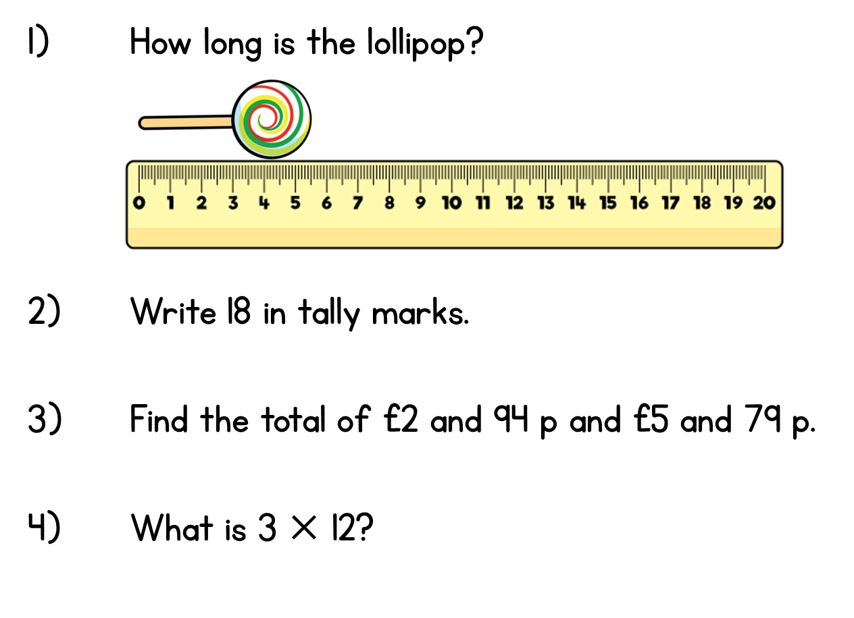




Year 3 | Week 7 | Day 4

Slide 5
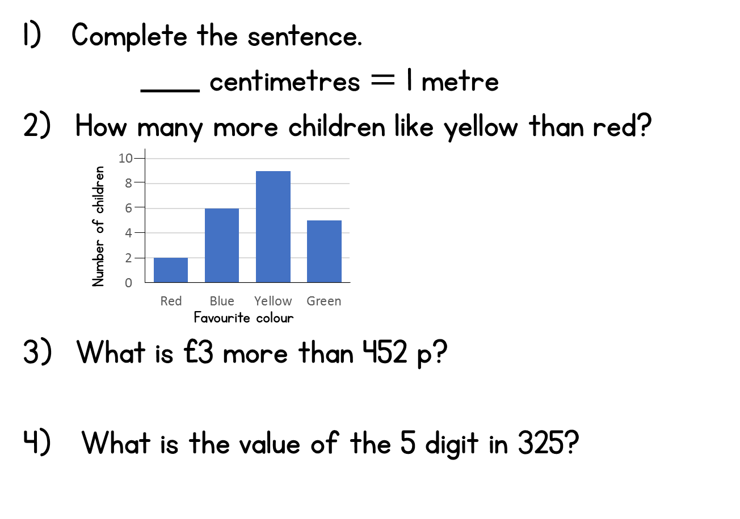




Year 3 | Week 7 | Day 5

Slide 6
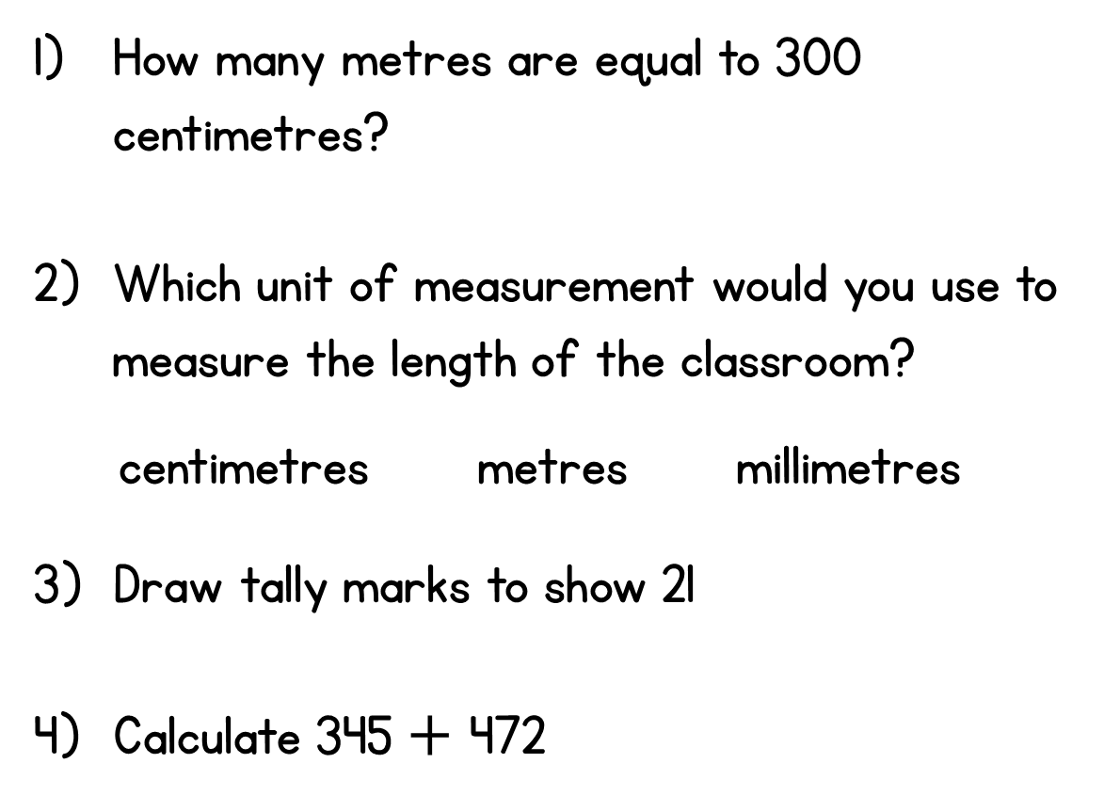



Year 3 | Week 8 | Day 1

Slide 7
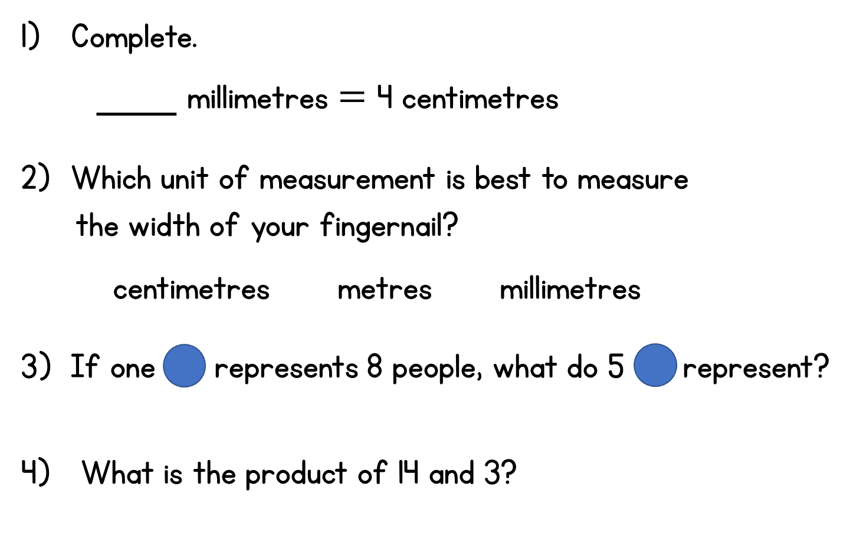



Year 3 | Week 8 | Day 2

Slide 8
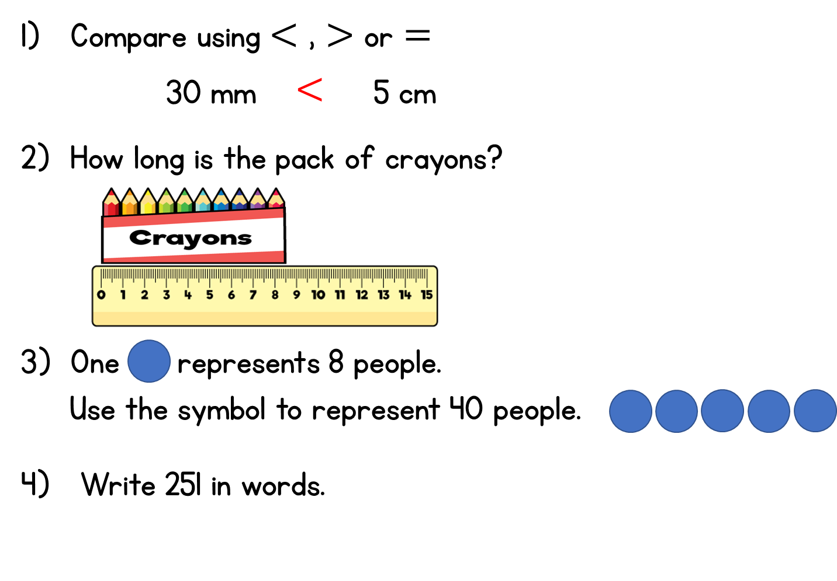



Year 3 | Week 8 | Day 3
$$<$$

Slide 9
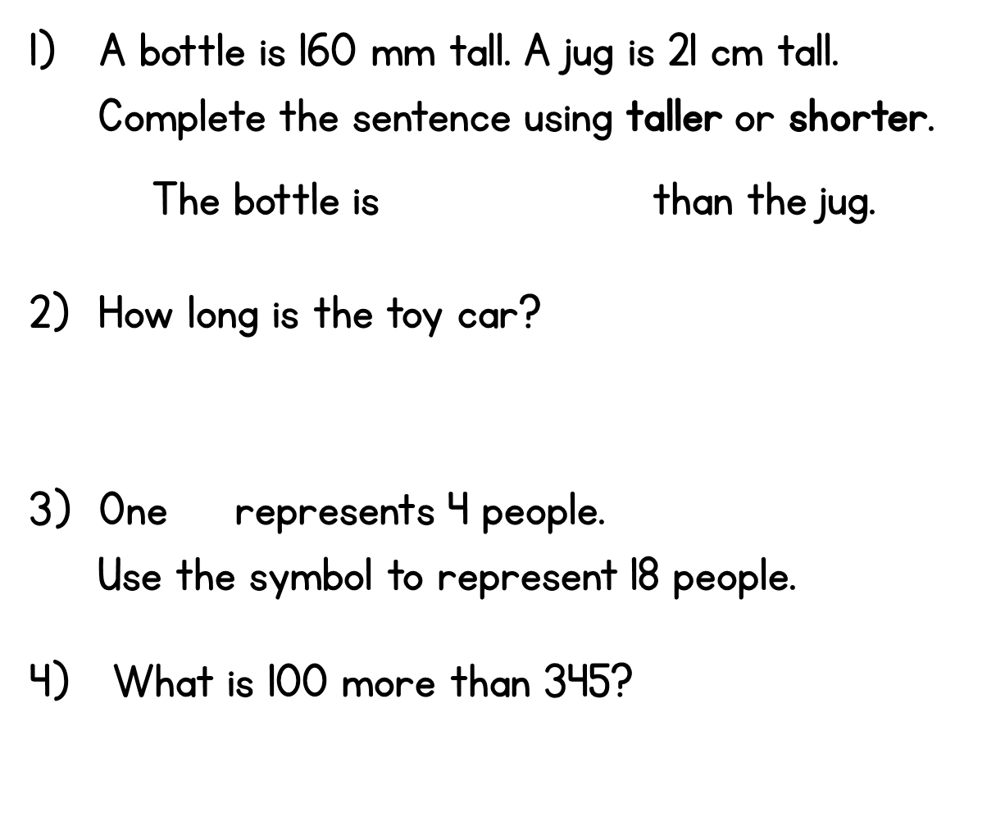


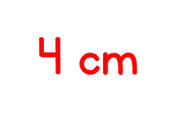


Year 3 | Week 8 | Day 4

Slide 10
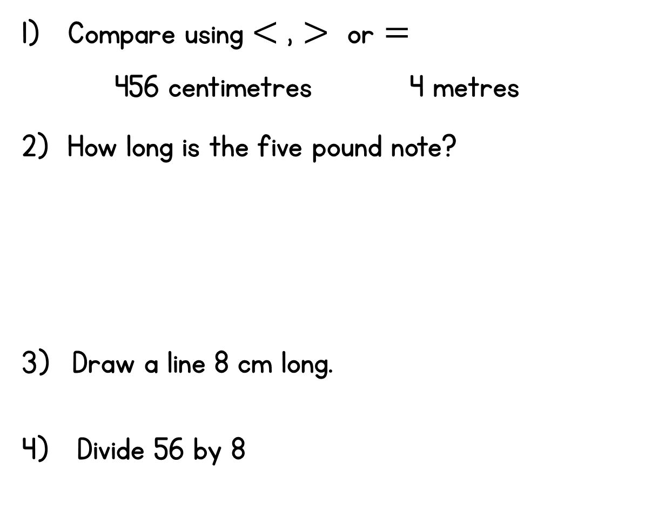
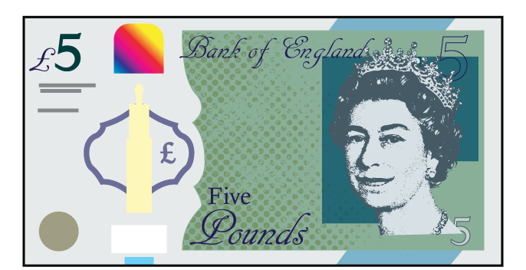



Year 3 | Week 8 | Day 5
$$>$$

Slide 11
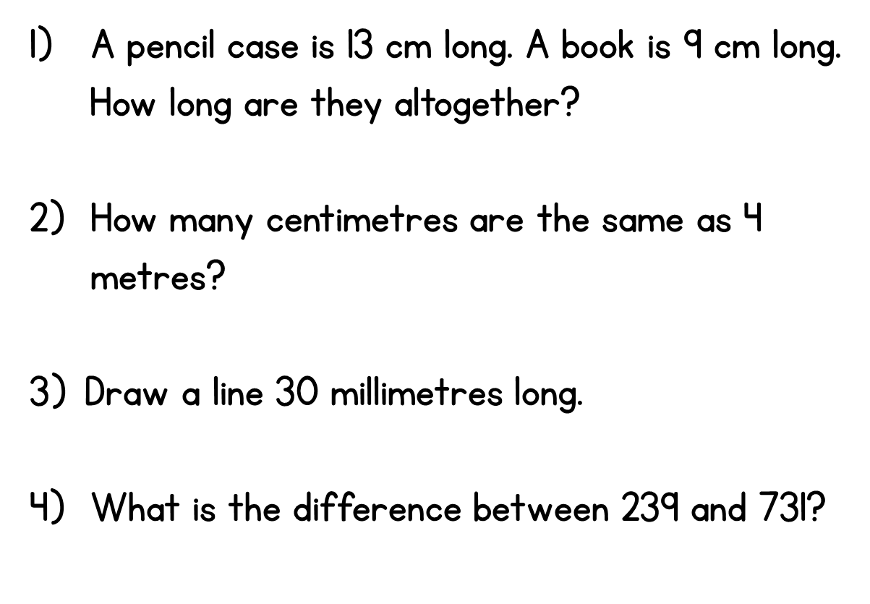



Year 3 | Week 9 | Day 1

Slide 12
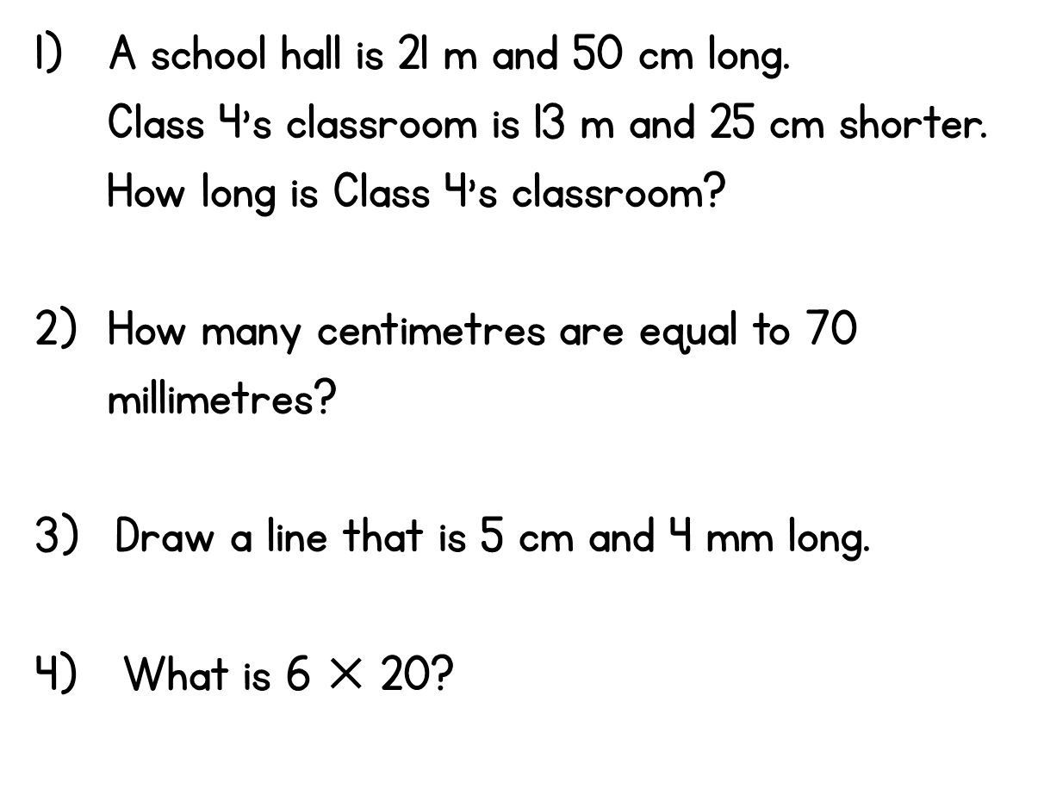


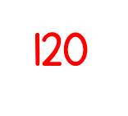
Year 3 | Week 9 | Day 2

Slide 13
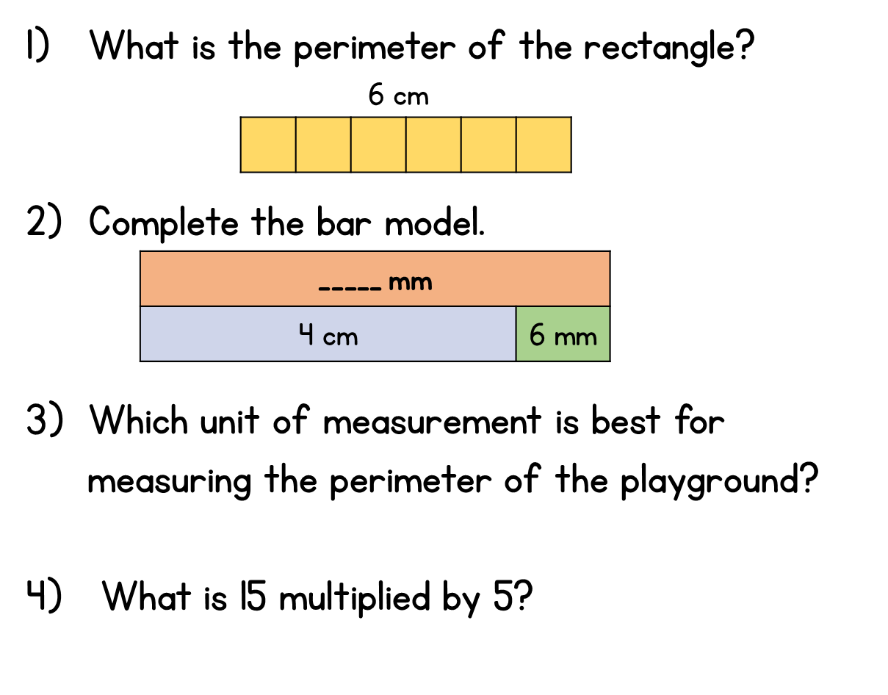



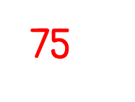
Year 3 | Week 9 | Day 3

Slide 14
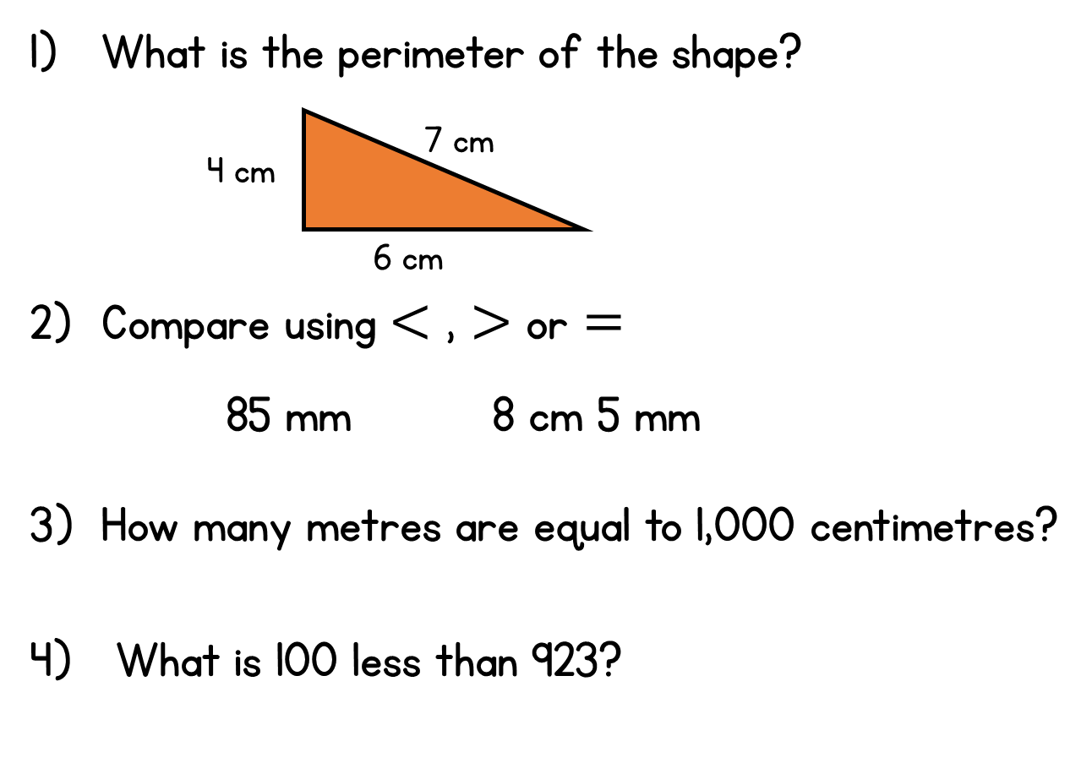




Year 3 | Week 9 | Day 4
$$=$$

Slide 15
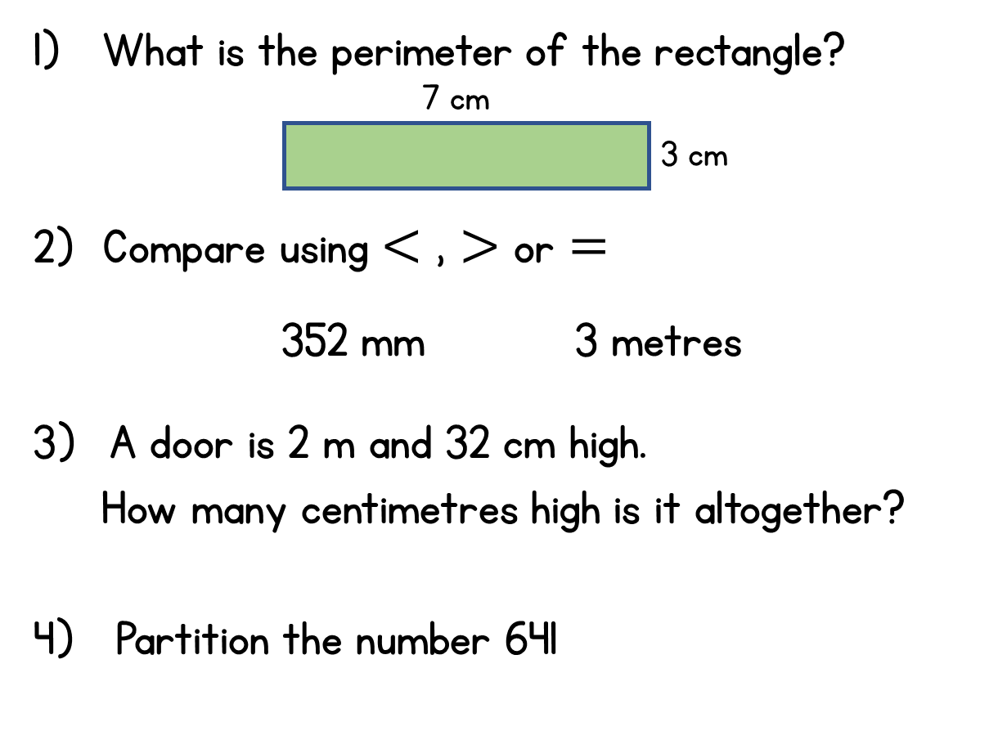
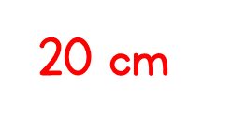



Year 3 | Week 9 | Day 5
$$<$$

